Slide 1



E-Commerce Taxation
A Global Standards-Based Architecture
Presented by Michael Slinn
With assistance from Khasnis Abhijit Suresh
Notes:
By Michael Slinn (mike@nextset.com)
The moratorium on Internet taxation in the United States is unprecedented. Almost nowhere else on earth is commerce of a certain category untaxed. Tax is collectable for goods sold over the Internet in most other countries. The US rationale was to allow commerce on the Internet the opportunity to grow - and the US position is different because the Internet is truly an American invention. In truth, there are approximately 30,000 tax authorities in North America, and the problem of being able to compute the tax for items sold from one tax jurisdiction to another within the US alone would indeed be a problem for smaller vendors.
Some of the issues raised when one stands back and looks at the concept of what taxation is, how it should be assessed, and how it should be collected are fundamental in nature. This article will not cover those philosophical and political issues, which have been widely reported. One source you might like to visit for up-to-date information on this aspect is the Congressional Advisory Commission on Internet Commerce. In this article we will focus on the technical aspects of Internet taxation, particularly new Internet standards that have been proposed and a general architecture for the administration, computation and collection of tax for commerce transacted over the Internet. The author has an international focus, and the approach taken treats the US tax environment as both transitory and merely one of many implementations.
About the author
Michael Slinn is a technical strategist based in Silicon Valley. He architected Data Kinetics‘ submission to the Advisory Commission on Internet Commerce under contract, and advised the company on the Internet standards process. Michael is currently Vice-President of Product Management at NextSet Software Inc.

Slide 2
Technology Vendors
Data Kinetics Ltd.
  High performance software for the Global 1000
  Leading E-commerce Standards
NextSet Software Inc.
  EJB enhancements

Slide 3





Future E-Commerce Taxation
B2C market will be $380 billion by 2003
Biggest
opportunity
in eCommerce
today
Tax jurisdictions don’t want to lose revenue
Tax computation has to be automated
EU is on the move
The whole world will join

Slide 4
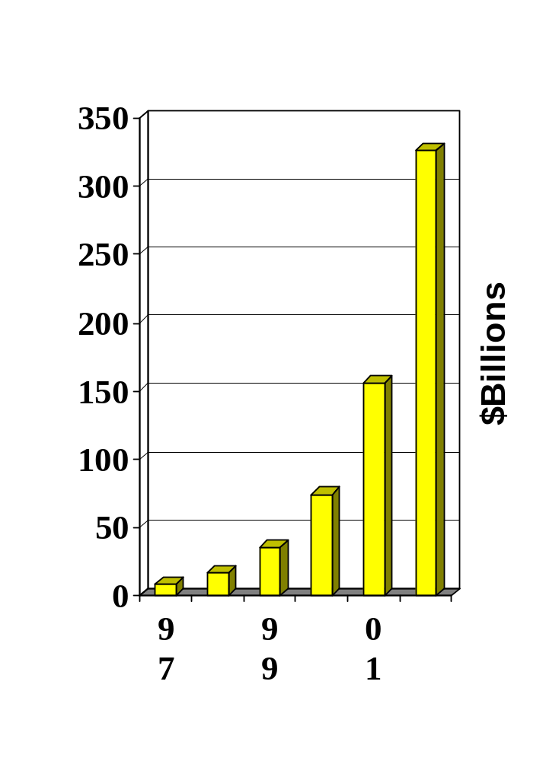
Internet Transactions ($Billions)
B2B goods and services will increase from $8 billion this year to $327 billion by 2002

Slide 5
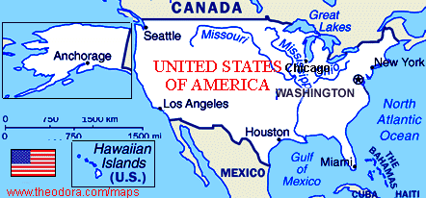

A brief taxation primer
Many countries require invoices to have tax properly displayed
Supplier must compute tax
Destination determines tax
Each country has different tax rules
Tax rules change frequently
Notes:
Many countries require that vendors present an invoice to the consumer with all taxes properly computed prior to finalizing the sale. That requirement means that the vendor must be able to determine all taxes - but taxes frequently change, and many factors enter into the computation.
Item classification. A standard classification code (http://www.spsc.org/ or http://www.customs.ustreas.gov/imp-exp/rulings/harmoniz/) is vital for automatic taxation.
Use. Tax frequently varies according to the use that an item is purchased for. For example, in Canada, items purchased for resale have the Goods and Services Tax (GST), but are Provincial Sales Tax (PST) exempt. PST is levied on most (but not all) sales to consumers, depending on the province and the type of item.
Country of Origin. Import duty and tax are very similar, and are handled without differentiation by the tax computation. For example, boats manufactured in foreign countries are assessed at different rates when imported into the USA, with differing rates for different countries.
Quantity or size.
Jurisdictions. The bill to, ship to and receipt to locations are all factors. For example, a purchasing agent in Miami might purchase a product from the UK and ship to a remote region in Medallin, Columbia. The product may be tax exempt from US or Florida taxes under these circumstances, and only subject to Columbian tax.
Tax rates and rules vary according to political whims. Invariably the vendor is liable for collecting the tax. If the vendor has a physical presence in a given jurisdiction, the local tax authorities have the legal ability to enforce collection of any tax they deem to be owing.

Slide 6

Internet Taxation Countries
Approx 50,000
Tax Jurisdictions
Use tax only

Slide 7
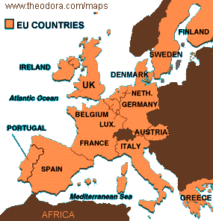
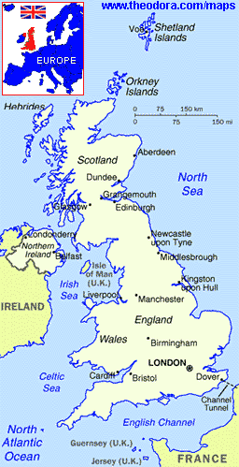

Taxation Hierarchy
For a seller based in San Francisco to sell goods to a person in London, he/she must reference the tax authorities of:
City Tax
Authority
National Tax Authority
European Union
British Tax Authority

Slide 8
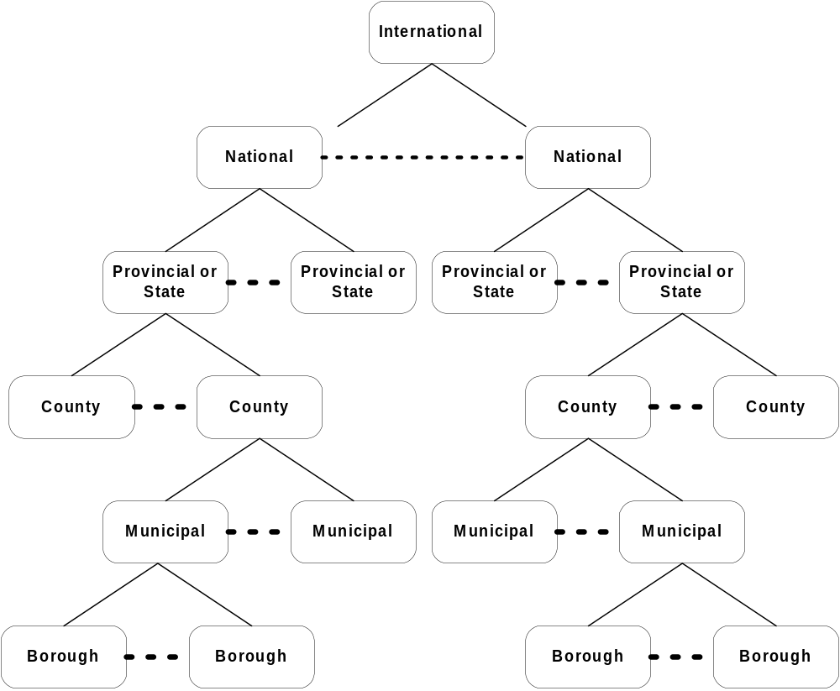
Tax Authority Hierarchy

Slide 9

This is a 'big idea' - very big!
Universal tax computation and collection
Connect every vendor world-wide
Real-time transactions
Standards are crucial
  XML
  EJB, DCOM
  Transactional queues
  Commodity codes
  Jurisdictional domains
Notes:
The requirements for a universal Internet tax collection system are daunting; nothing less than interconnecting all of the world's e-commerce vendors with a global network of tax authorities and performing real-time transactions. Standards are the key to transacting business between disparate computing platforms, and therefore Internet taxation requires the usage of existing standards, as well the creation of new standards. This article will survey the standards envisioned in the final solution: XML, Enterprise Java Beans, DCOM, transactional queues, classification schemes for merchandise, a new top-level Internet domain, and a customizable hierarchy of tax authority servers.

Slide 10

Global Connectivity Technology
Interoperability between heterogeneous systems is vital
The XML and EJB standards interoperate
Asynchronous communications
EJB provides scalable component based architecture
Notes:
The architecture has to scale to unprecedented size - the vision is nothing short of a global network of interconnected machines receiving tax revenue from every e-commerce server on the planet. Special consideration was given to interoperability. Enterprise Java Beans offers a very nice distributed paradigm, and is able to integrate well in heterogeneous environments. One of its drawbacks has been that all remote procedure calls are synchronous in nature. This means that if a network connection should drop, transactions over that connection would fail. Synchronous calls also block the calling program, and only return when complete or upon failure.
Asynchronous connectivity has long been used for greater throughput and reliability. Transactional queues such as IBM's MQ Series and the Borg's MSMQ provide a delivery guarantee, and can be programmed to reroute messages between systems should a communications failure occur. Asynchronous connectivity is often referred to as 'loose coupling' because the computers at both end of the connection can run at full speed, without waiting for the results of a query from the other machine. Overall this greatly speeds up throughput between the two computers, and provides for the business processes of two or more enterprises to exchange information at much greater rates and with greater reliability than via synchronous calls.
Many asynchronous products exist, but unfortunately the Enterprise Java Beans standard currently only provides synchronous facilities for remote procedure invocation and messaging. The EJB 2.0 specification, when complete, will support asynchronous connectivity. The specification is due to be finalized in the summer of 2000, and commercial implementations should be available shortly thereafter.

Slide 11


EJB Features
Logic components are called EJBs
Containers manage EJBs

Slide 12






Formal EJB Roles
Distinct roles:
  EJB provider (creates and sells EJBs)
  Application assembler (uses EJBs to build an application)
  Container provider (creates and sells EJB containers)
  Server provider (creates and sells EJB server )
  Deployer (sets permissions, etc.)
  System administrator

Slide 13
EJB Container Services
Transaction Management
Security
Remote Client Connectivity
Life Cycle Management
Data Source Connection Pooling
Synchronous connectivity only (HTTP, IIOP)

Slide 14


NextSet EJB Enhancements
Asynchronous containers
  Upwards compatible with normal EJB containers
  Extends client contract
Proxy beans
  Expose remote objects as local objects
Notes:
Fortunately a Silicon Valley company has already published an asynchronous extension to the EJB standard and has developed products that directly address the design challenge that faced in this project. The company, GlueBeans, has recently been acquired by NextSet Software, Inc. and the product range is being filled out at a greater rate as a result of the acquisition. The two main features of the GlueBeans technology are directly applicable to business to business transactions: asynchronous EJB and proxy beans. Software projects that utilize asynchronous EJB connectivity via GlueBeans technology should be portable to the EJB 2.0 implementation with little or no effort, since the details of that connectivity are handled by the EJB container, and not in the business logic.
Proxy beans are a method of virtually exporting server-side objects to be hosted on other machines, so the methods and properties of the remote objects appear to be local to the local program. Similar to how EJB clients use JNDI to look up the location of an EJB running on a host, and are then able to access the EJB's methods and properties remotely through the synchronous stub/skeleton mechanism, proxy beans provide asynchronous access to remote objects. Proxy beans are a slick way to use EJB as an integration platform for a variety of back-end servers at remote locations.

Slide 15
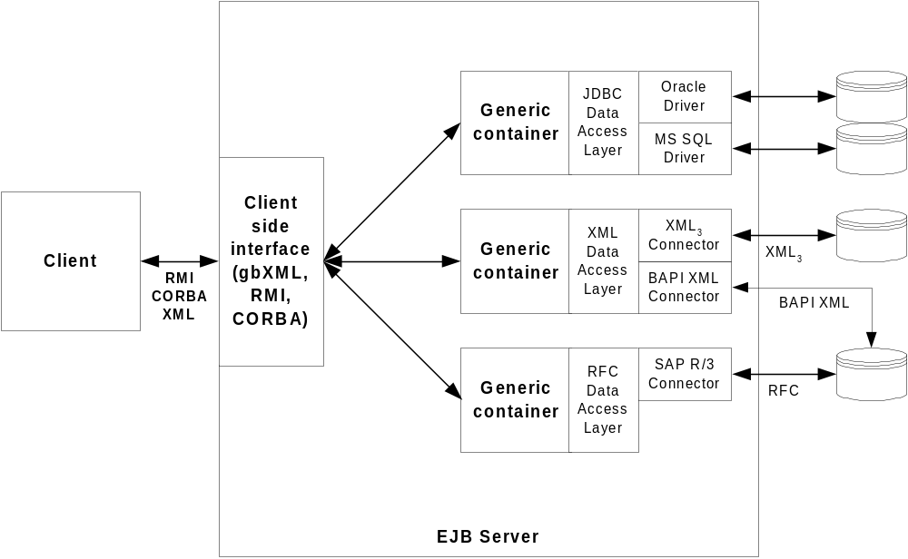
NextSet EJB Data Interfaces

Slide 16
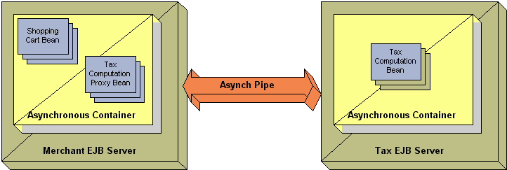
AsynchEJB™ and Proxy Beans™

Slide 17
Extended EJB Container Benefits
EJBs can deal with pure business logic
Data transport choice made after EJB coded
No hard coded connections
No data replication issues

Slide 18
Proxy Bean™ Benefits
All the benefits of extended containers apply
Remote objects appear to be local
Network topology determined at deployment time, not when bean is coded
Objects can be remotely deployed with different permissions

Slide 19
Taxation Requirements
Capture, store and rationalize the taxation rule bases of differing tax administrations
Execute the rules to calculate taxes
Language translation
Currency conversion
Summarize transaction statistics
Summarize commodity usage statistics
Caching to ensure high performance

Slide 20
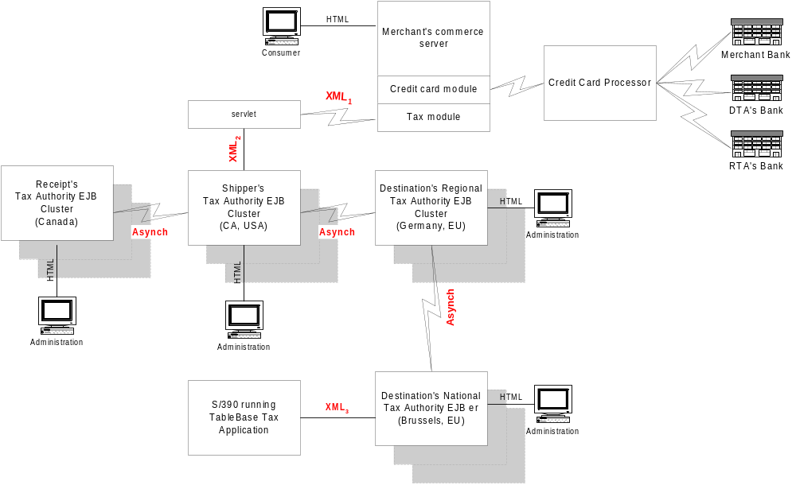
International Tax System

Slide 21
E-Commerce Tax XML₁ Packet
<?xml version="1.0"?>
<!DOCTYPE transaction SYSTEM "http://tax.w3.org/tax.dtd">
<Transaction Currency="US" Locale="EN.US“ MerchantID="A1B2C3.US“
ConsumerOrderID="20011015A01“
ItemCount=“2“ TimeStamp="1234567890">
<Jurisdiction BillTo="LA.CA.US“
ShipTo="AK.US" ReceiptTo=“SE.WA.US"/>
<Item Id="1" MFR_Name="ABC Corp.“ MFR_Jurisdiction="VT.US“
Quantity=“1” Classification="9506.19.00“ Value="1.23“
Use="education"/>
<Item Id="2" MFR_Name="XYZ, Inc." MFR_Jurisdiction="ON.CA“
Quantity=“1” Classification="9505.10.00" Value="44.55“
Use="manufacturing"/>
</Transaction>
TransactionBean
  Currency
  Locale
  MerchantID
  ConsumerOrderID
  ItemCount
  TimeStamp
  Jurisdiction
  Item[]
TransactionHome
  create(…)
TransactionRemote
  computeTax()
Item Class
Id
MFR_Name
MFR_Jurisdiction
Quantity
Classification
Value
Use
Jurisdiction Class
BillTo
ShipTo
ReceiptTo

Slide 22
Servlet Calls EJB via XML

Slide 23
XML₂ Generated by Servlet 1/2
<Jurisdiction BillTo="LA.CA.US“
ShipTo="AK.US" ReceiptTo="WA.WA.US"/>
<gbxmlQueryRequest>
<homeinterface>TransactionHomeInterface</homeinterface>
<methodname>create</methodname>
<params type=“MethodArguments”>
<param name=“Currency” value=“US” type=“String” />
<param name=“Locale” value=“EN.US” type=“String” />
<param name=“MerchantID” value=“A1B2C3.US” type=“String” />
<param name=“ConsumerOrderID” value=“20011015A01” type=“String” />
<param name=“ItemCount” value=“4” type=“String” />
<param name=“TimeStamp” value=“1234567890” type=“String” />
<params name=“Jurisdiction” type=“Object”>
<param name=“BillTo” value=“LA.CA.US” type=“String”/>
<param name=“ShipTo” value=“AK.US” type=“String”/>
<param name=“ReceiptTo” value=“WA.WA.US” type=“String”/>
</params>
… continued on next slide
<Transaction Currency="US" Locale="EN.US“ MerchantID="A1B2C3.US“
ConsumerOrderID="20011015A01“
ItemCount=“2“ TimeStamp="1234567890">

Slide 24
XML₂ Generated by Servlet 2/2
… continued from previous slide
<params name=“Item” type=“ObjectArray”>
<params name=“Item” type=“Object”>
<param name=“Id” value="1" type=“String” />
<param name=“MFR_Name” value="ABC Corp.“ type=“String” />
<param name=“MFR_Jurisdiction” value="VT.US“ type=“String” />
<param name=“Classification” value="9506.19.00“ type=“String” />
<param name=“Value” value=“1.23 “ type=“String” />
<param name=“Quantity” value=“1 “ type=“Float” />
<param name=“Use” value="education“ type=“String” />
</params>
<params name=“Item” type=“Object”>
<param name=“Id” value=“2" type=“String” />
<param name=“MFR_Name” value=“XYZ, Inc.“ type=“String” />
<param name=“MFR_Jurisdiction” value=“ON.CA“ type=“String” />
<param name=“Classification” value="9505.10.00“ type=“String” />
<param name=“Value” value=“44.55 “ type=“String” />
<param name=“Quantity” value=“1“ type=“Float” />
<param name=“Use” value="education“ type=“String” />
</params>
</params>
</gbxmlQueryRequest>
<Item Id="1" MFR_Name="ABC Corp.“ MFR_Jurisdiction="VT.US“
Quantity=“1” Classification="9506.19.00“ Value="1.23“
Use="education"/>

Slide 25
Computing Tax
XML to EJB layer
EJB to low-level Java Interface
C Code using JNI for rules processing with net.TABLES
Rule base drives computations
Rule base is administered by each tax authority

Slide 26
EJB returns XML₂

Slide 27
EJB Generated XML₂
<gbxmlresponse>
<params type=“Object”>
<param name=“Tax RefNo” value="USCALA.A1B2C3.20011015A01.NODE1.1“ />
<params name=“Tax_Item” type=“ObjectArray”>
<param name=“Id” value="1“>
<params name=“Tax_Item_Jurisdiction” type=“ObjectArray”>
<param name="US" Value="0“ />
<param name="CA.US" Value="0“ />
<param name="LA.CA.US" Value="0“ />
<param name="WA.US" Value="0“ />
<param name="WA.WA.US" Value="0“ />
<param name="AK.US" Value="0“ />
</params>
<param name=“Tax_Item_Note” value=“Item is no longer taxed in US according to Federal Tax Ruling 19990401A2D.” />
</param>
<param name=“Id” value=“2“>
<params name=“Tax_Item_Jurisdiction” type=“ObjectArray”>
<param name="US" Value=“2.34“ />
<param name="CA.US" Value=“1.23“ />
<param name="LA.CA.US" Value="0“ />
<param name="WA.US" Value="0“ />
<param name="WA.WA.US" Value="0“ />
<param name="AK.US" Value="0“ />
</params>
</param>
</params>
</gbxmlresponse>

Slide 28
Servlet returns XML₁

Slide 29
Servlet Generated XML₁ Response
<Tax RefNo="USCALA.A1B2C3.20011015A01.NODE1.1“ />
<Tax_Item Id="1">
<Tax_Item_Jurisdiction="US" Value="0"/>
<Tax_Item_Jurisdiction="CA.US" Value="0"/>
<Tax_Item_Jurisdiction="LA.CA.US" Value="0"/>
<Tax_Item_Jurisdiction="WA.US" Value="0"/>
<Tax_Item_Jurisdiction="WA.WA.US" Value="0"/>
<Tax_Item_Jurisdiction="AK.US" Value="0"/>
<Tax_Item_Note value=“Item is no longer taxed in US according to Federal Tax Ruling 19990401A2D.”>
</Tax_Item>
<Tax_Item Id="2">
<Tax_Item_Jurisdiction="US" Value="2.34"/>
<Tax_Item_Jurisdiction="CA.US" Value="1.23"/>
<Tax_Item_Jurisdiction="LA.CA.US" Value="0"/>
<Tax_Item_Jurisdiction="WA.US" Value="0"/>
<Tax_Item_Jurisdiction="WA.WA.US" Value="0"/>
<Tax_Item_Jurisdiction="AK.US" Value="0"/>
</Tax_Item>

Slide 30
XML Container with XML₃ Connector

Slide 31
NextSet EJB Data Interfaces
Let’s discover how to map beans to XML

Slide 32

XML to EJB Mapping
NextSet Server
XML Container
Java classes
for non-terminal
XML elements
XML
Parser
XML
DTD
EJB classes:
- home interface
- remote interface
- primary key
- bean
- deployer
XML
DTD

Slide 33
Bean Deployment Purposes
Deployment establishes:
  Access control
  Security restrictions
  Transaction characteristics
  Role
  Data Source
    URL
    File

Slide 34

XML Bean Deployment Actions
NextSet Server
XML Adapter
XMLNon-terminal element classes
XML Data
Deployer
Stub
Skeleton
Stub
Jar File
Bean Files

Slide 35
System Data Flow
Compute Tax

Slide 36

Take Note … It’s Happening!
E-Commerce taxation first in Europe
Cutting edge technology
Open standards are key
Vital in future global e-commerce

Slide 37
Questions and Answers
E-Commerce Taxation

